Slide 1
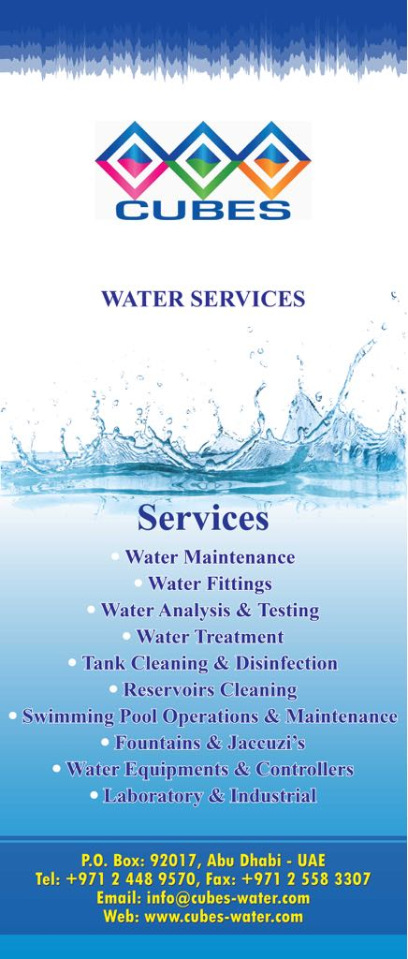
Cubes Water Services
COMPANY PROFILE

Slide 2
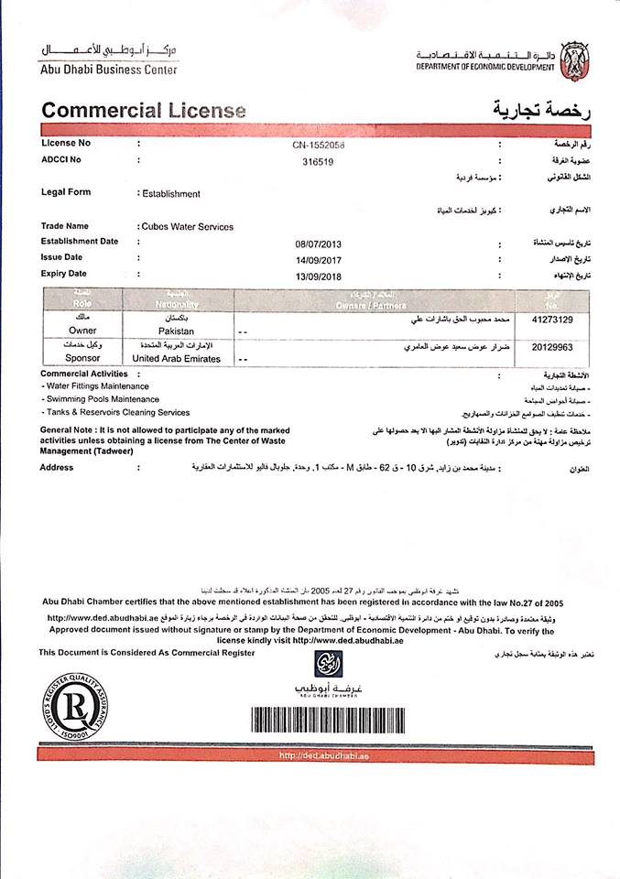
COMPANY TRADE LICENSE

Slide 3
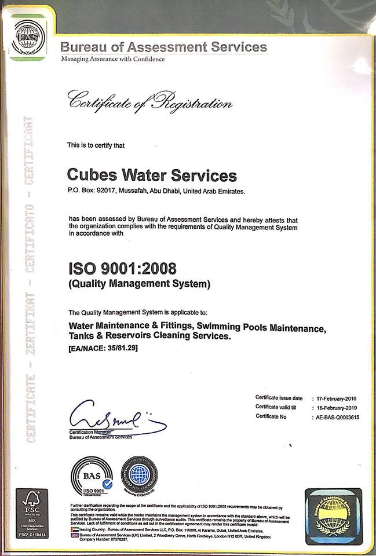
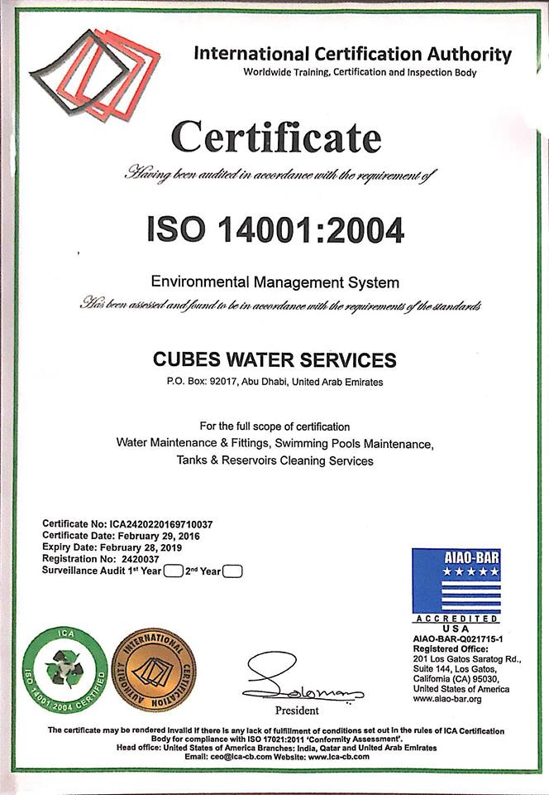
OUR CERTIFICATES

Slide 4
COMPANY OVERVIEW
Cubes Water Services is a ISO certified water services company specialized in water field and divided mainly in three divisions:
• Water Fittings & Maintenance Services
• Tanks & Reservoirs Cleaning Services
• Swimming Pools Maintenance
Cubes Water Services comprises of dedicated team of professionals
• To provide servicing , facilities, operation, maintenance objectives for the end user at the maximum satisfaction and accomplishment.
• To provide best quality products with guarantee of care services, whenever required.
Cubes Water Services is an establishment that retains a tradition of integrity and is on the road to expansion in line with the market trends

Slide 5
Water Maintenance & Fittings
Cubes Water Services focuses on providing an extensive range of operation and maintenance facilities for Water Systems, Equipment, Fittings, Piping, Stations, Tanks, Networks and Loops.
Whatever clients do with water, we can help them maximize efficiencies and effectiveness whilst being considerate to the environment.
CWS has established a standing for providing high quality customer service and operational excellence through a broad range of services, water supply management, design, build and maintenance of water assets, customized and sustainable solutions to optimize cycles.

Slide 6
CWS technological quality solutions for all types of water systems.
Supply and services for Butterfly Valves, Ball and Gate Valves, Pneumatic & Actuated Valves, Hydraulic Valves, Check Valves, Pressure Release Valves, Foot Valves and Solenoid Valves
Flanged and Galvanized Fittings, Cartridges, Filters and Strainers, Nozzles, Unions, Couplings, Elbows, Tees, Gaskets and Coupons.
Flow meters, Sprinklers and Emitters, Controllers, Corrosion Racks, Water timers and Decoders, Piping, Connections
Expansion Joints, Tanks, Hoses and fittings, Dosing pumps, UV Systems, Pumps
Strainer, Lamps & Underwater, Fire Extinguishers and First Aid, Safety and Awareness Sign Boards, Heaters, Coolers, Filters and Faucets, Water Timers and Decoder.

Slide 7
Cooling & Chilled Water Operation, Maintenance and Treatment Testing Program.
Domestic Potable Water Facility, Supply Lines, Dosing, Treatment, Testing and Piping connections.
Condenser, Feed and Boiler Water Program
Recycling, Reuse, Reverse Osmosis systems
Flushing, Cleaning & Passivation, Filtration
Mothballing facility
Maintenance and installation of Tanks, Basin, Fills, Casing units
Blow down, Reagents, Test kits, Calorimeters
Fountain, Show case, Sprayer, Shower systems
Irrigation and water side loops

Slide 8
Tanks & Reservoirs Cleaning
Cubes Water Services provides methods to meet standard quality parameters and to remove dissolved solids, suspended matters, sand, silt, floating and sticky spots, algae, fungi, organic compounds and micro organisms.
Cleaning with chlorination and food grade methods
Disinfection, sterilization facility
Preservation, Vacuuming of water lines
Manual washing, Pumping, Draining, Pressure services
Piping Loops Flushing, Descaling, Disposal, Jointing, Brushing
Wet Lay ups, Idling treatments
Approved Laboratory Test provision

Slide 9
Swimming Pools Maintenance
Cubes Water Services handles complete operation and maintenance, design, supply, installation, commissioning and testing services of swimming pools, ponds, lakes, water walls, recreation areas ranging from commercial to residential and private sectors for the following
Filtration Pumps, Make up feed and Pool Filters
Poolside Equipment including Ladders, Shower and accessories, Handrails, Chairs, Overflow grating, Starting blocks, Slides
Pool Basin Equipment including drainage fixtures, Nozzles, Control and Regulation including water meters, pressure gauge panels
UV ionizers, Controller, Control panel, Check valves, Anti-vibration bushings and pads, Dosing pumps, Heating, Cooling equipment.
Brushing, Shocking and Vacuuming Equipment, Treatment Chemicals (Bio control, Clarity, Alkalinity)

Slide 10
References

Slide 11
S.N | PROJECTS
1 | Ministry of Education & Justice-Dubai
2 | The Dubai Mall-Dubai
3 | Ministry of Health & Prevention-Dubai
4 | Ministry of Foreign Affairs-Dubai
5 | Ministry of Infrastructure & Development-Dubai
6 | Ministry of Humen Resources & Emiratisation-Dubai
7 | Dubai Industrial City-Dubai
8 | General Directorate of Youth & Sports-Dubai

Slide 12
S.N | PROJECTS
9 | Abu Dhabi International Airport-Abu Dhabi
10 | Al Dar Head Quarter-Abu Dhabi
11 | Zayed University-Abu Dhabi
12 | Musanada (ADEC) Schools-Al Ain
13 | Al Mamoura Towers-Abu Dhabi
14 | Khalifa Port KIZAD-Abu Dhabi
15 | Baniyas Towers-Abu Dhabi
And many more…
16 | Al Dar Academies-Abu Dhabi

Slide 13
Partners Joint Ventures

Slide 15
Photo Gallery

Slide 16
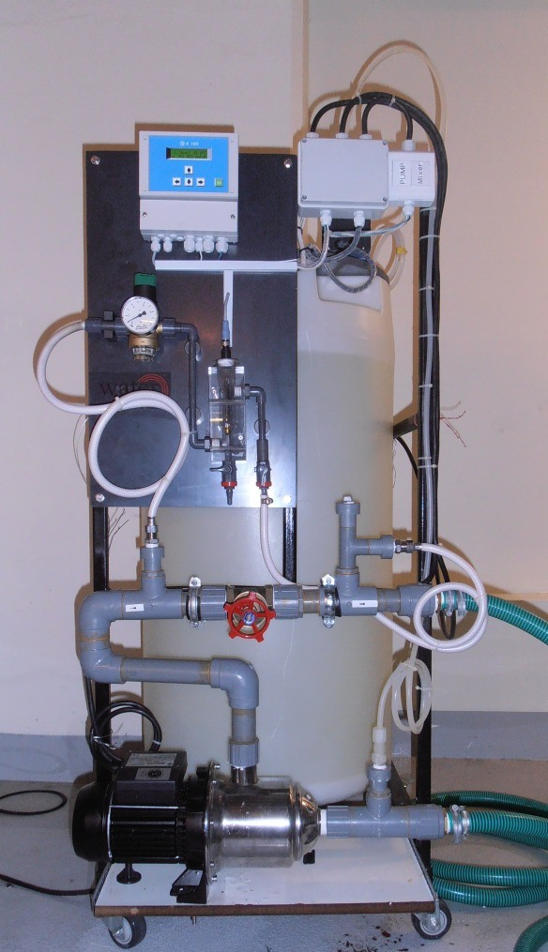
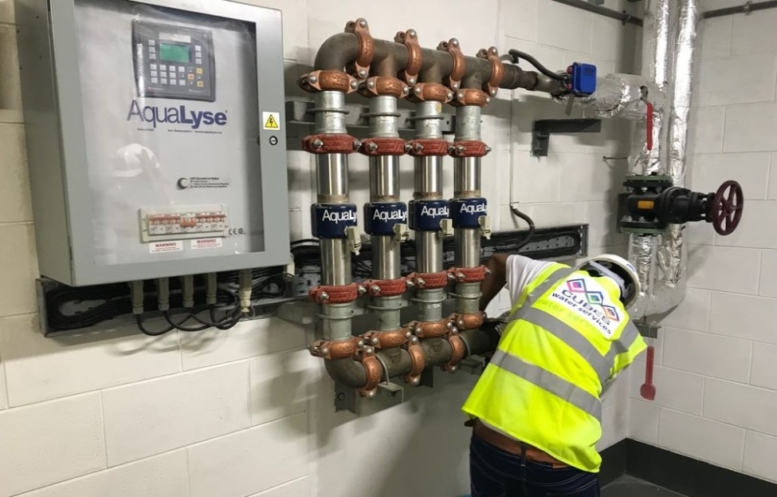
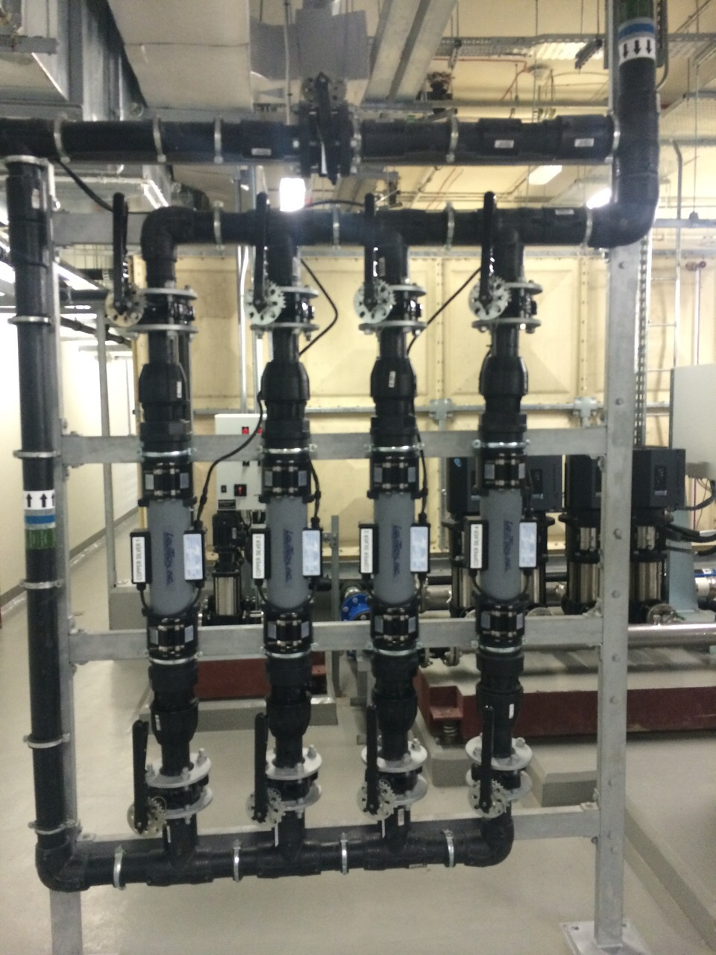
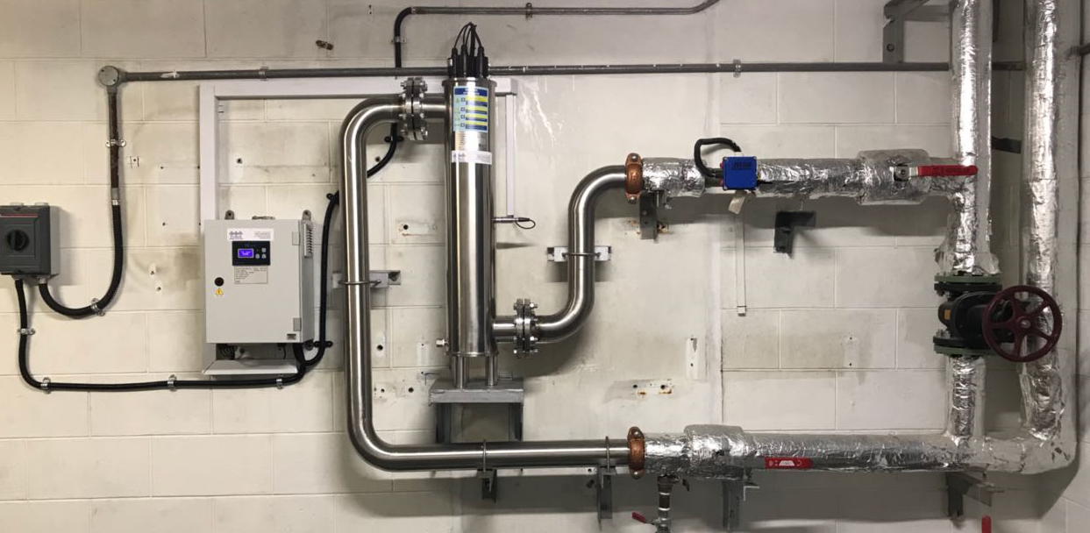

Slide 17
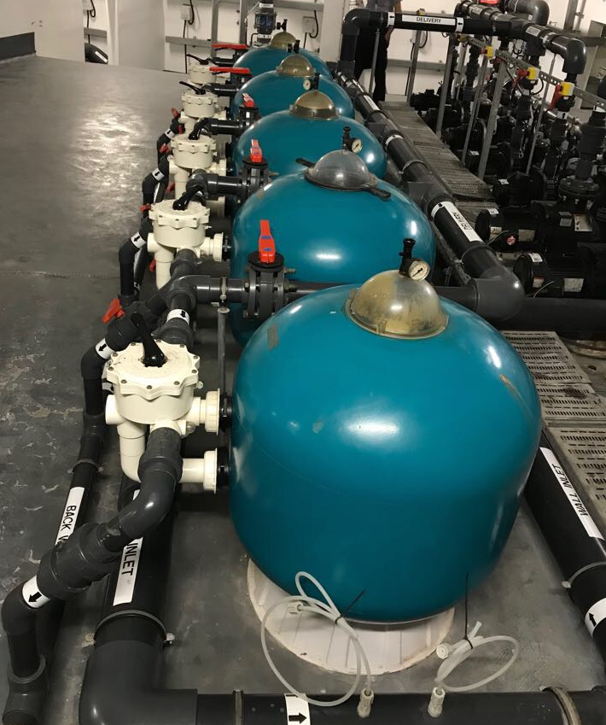
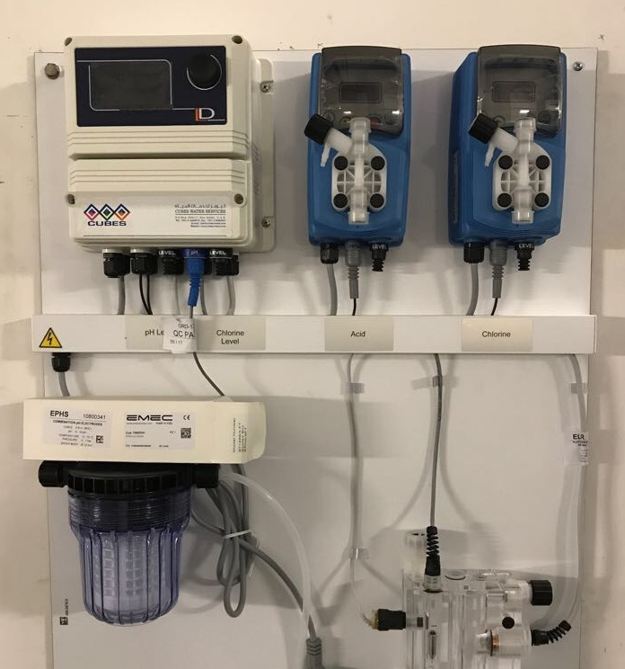
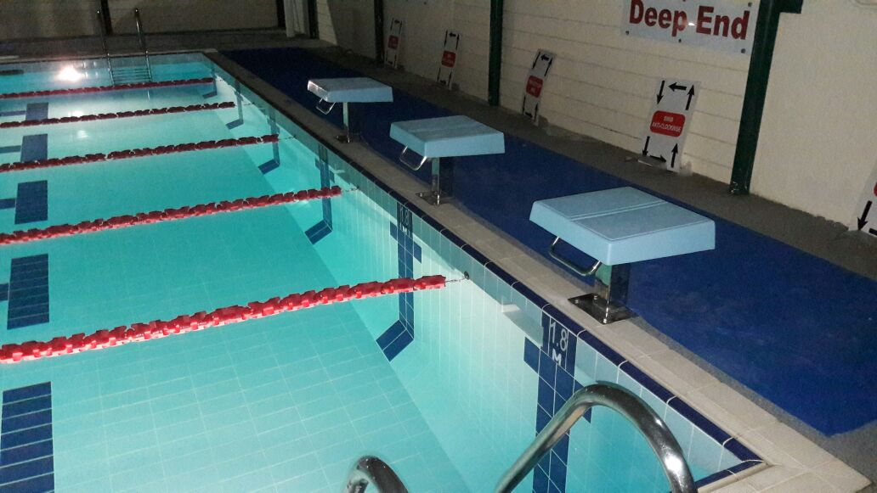

Slide 18
